Slide 1
Evens Alexis
Section 10.2
_*Personal Loans and Simple Interest*_
Please student take notes this section can very confusing

Slide 2
What You Will Learn
Upon completion of this section, you will be able to:
Use the simple interest formula to calculate ordinary interest.
Use the United States Rule to solve simple interest problems.

Slide 3
Personal Loans
The amount of credit extended or the principal of the loan and the interest rate that you may obtain depend on the assurance that you can give the lender that you will be able to repay the loan.
Security (or collateral) is anything of value pledged by the borrower that the lender may sell or keep if the borrower does not repay the loan.

Slide 4
Personal Loans
A personal note is a document (or agreement) that states the terms and conditions of the loan.
Bankers sometimes grant loans without security, but they require the signature of one or more other persons, called cosigners, who guarantee the loan will be repaid.

Slide 5
Interest
Interest is the money the borrower pays to use the lender’s money.
Simple interest is based on the entire amount of the loan for the total period of the loan.

Slide 6
Simple Interest Formula
p is the principal, the amount of money borrowed or loaned
r is the rate of interest, as a decimal
t is the time; days, months, or years

Slide 7
Simple Interest Formula
The most common type of simple interest is called ordinary interest. For computing ordinary interest, each month has 30 days and a year has 12 months or 360 days. On the due date of a simple interest note the borrower must repay the principal plus the interest.

Slide 8
Example 1: New Roof Loan
Sherry needs to borrow $6200 to replace the roof on her home. From her credit union, Sherry obtains a 30-month loan with an annual simple interest rate of 5.75%.
a) Calculate the simple interest she is charged on the loan.

Slide 9
Example 1: New Roof Loan
Solution
a) p = $6200
r = 0.0575
t = 30 ÷ 12 = 2.5
i = p × r × t
= $6200 × 0.0575 × 2.5
= $891.25
The simple interest on $6200 at 5.75% for 30 months is $891.25.

Slide 10
Example 1: New Roof Loan
b) Determine the amount, principal plus interest, Sherry will pay the credit union at the end of the 30 months to pay off her loan.
Solution
The amount to be repaid is equal to the principal, $6200, plus the interest, $891.25.

Slide 11
Example 1: New Roof Loan
Solution
A = p + i
= $6200 + $891.25
= $7091.25
To pay off her loan, Sherry will pay the credit union $7091.25 at the end of 30 months.

Slide 12
Discount Notes
In another type of loan, the discount note, the interest is paid at the time the borrower receives the loan.
  The interest charged in advance is called the bank discount.

Slide 13
Example 4: True Interest Rate of a Discount Note
Evens took out a $500 loan using a 10% discount note for a period of 3 months. Determine
a) the interest she must pay to the bank on the date she receives the loan.
b) the net amount of money she receives from the bank.
c) the actual rate of interest for the loan.

Slide 14
Example 4: True Interest Rate of a Discount Note
Solution
a) i = prt
= $500 × 0.10 × 3/12
= $12.50
b) the net amount = $500 – 12.50
= $487.50

Slide 15
Example 4: True Interest Rate of a Discount Note
Solution
c) i = prt
$12.50 = $487.50 × r × 3/12
12.50 = 121.875r
r = 12.50 ÷ 121.875
r ≈ 0.1026
Thus, the actual rate of interest is about 10.3% rather than the quoted 10%.

Slide 16
The United States Rule
A payment that is less than the full amount owed and made prior to the due date is known as a partial payment.
A Supreme Court decision specified the method by which these payments are credited. The procedure is called the United States rule.

Slide 17
The United States Rule
The United States rule states that if a partial payment is made on the loan, interest is computed on the principal from the first day of the loan until the date of the partial payment.

Slide 18
The United States Rule
  The partial payment is used to pay the interest first; the rest of the payment is used to reduce the principal.
  The balance due on the date of maturity is found by computing interest due since the last partial payment and adding this interest to the unpaid principal.

Slide 19
Banker’s Rule
The Banker’s rule is used to calculate simple interest when applying the United States rule.
The Banker’s rule considers a year to have 360 days, and any fractional part of a year is the exact number of days of the loan.

Slide 20
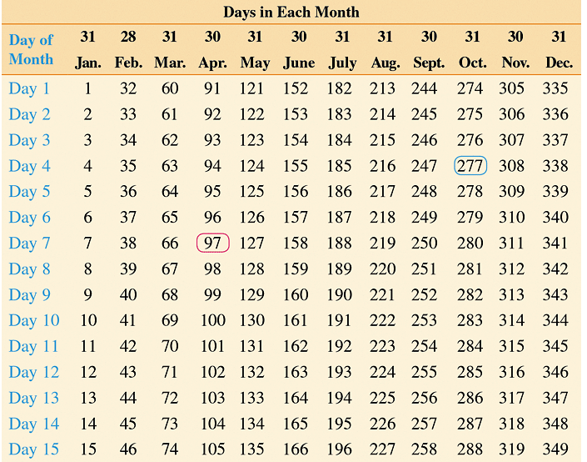
Banker’s Rule- Table 10.1

Slide 21
Banker’s Rule- Table 10.1

Slide 22
Example 8: Using the United States Rule
Mrs. Washington-S is a mathematics teacher, and she plans to attend a national conference. To pay for her airfare, on November 1, 2014, she takes out a 120-day loan for $400 at an interest rate of 12.5%. Mrs. Washington uses some birthday gift money to make a partial payment of $150 on January 5, 2015.

Slide 23
Example 8: Using the United States Rule
She makes a second partial payment of $100 on February 2, 2015.
a) Determine the due date of the loan.
Solution
From Table 10.1, Nov 1 is the 305th day of year. 305 + 120 = 425 goes into the next year so subtract 365.
425 – 365 = 60; March 1, 2015

Slide 24
Example 8: Using the United States Rule
b) Determine the interest and the amount credited to the principal on January 5.
Solution
Jan 5 is 5th day of the year and Nov 1 is the 305th day of year.
(365 – 305) + 5 = 65
i = $400 × 0.125 × 65/360 ≈ $9.03

Slide 25
Example 8: Using the United States Rule
Solution
The interest $9.03 is deducted from the $150, leaving $140.97 to be credited to the principal.
The adjusted principal is
$400 – 140.97 = $259.03.

Slide 26
Example 8: Using the United States Rule
c) Determine the interest and the amount credited to the principal on February 2.
Solution
Use Banker’s rule to calculate interest on the unpaid principal from Jan 5 to Feb 2. 33 – 5 = 28 days
i = $259.03 × 0.125 × 28/360 ≈ $2.52

Slide 27
Example 8: Using the United States Rule
Solution
The interest $2.52 is deducted from the $100, leaving $97.48 to be credited to the principal.
The adjusted principal is
$259.03 – $97.48 = $161.55.

Slide 28
Example 8: Using the United States Rule
d) Determine the amount that Washington must pay on the due date.
Solution
Due date is Mar 1; 60th day of year.
60 – 33 = 27 days, Feb 2 to Mar 1.
i = $161.55 × 0.125 × 27/360 ≈ $1.51
The balance due is $161.55 + $1.51 = $163.06

